Slide 1
SDN Engineering
Nikhil Khatu

Slide 2
Presentation Overview
Traditional Networking vs SDN
Industry
Relevant research
CMMI-dev Engineering
Future research and conclusion

Slide 3
Traditional Networking
Switching
Built on Layer 2 learning and ARP protocols
Routing
Enterprise, Internal Service Provider use RIP, OSPF, IGRP
Internet uses BGP, ISIS
Service Providers use MPLS

Slide 4
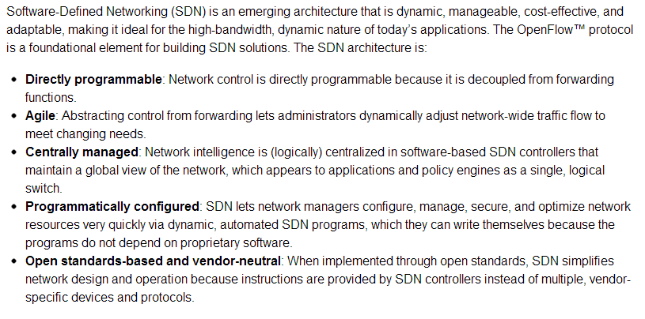

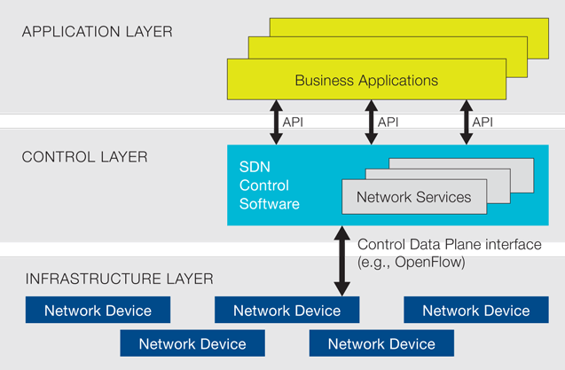
What is SDN?
https://www.opennetworking.org/
C, C++, Python, Java, etc…
Verilog, VHDL, SystemC
Various Networking Protocols

Slide 5
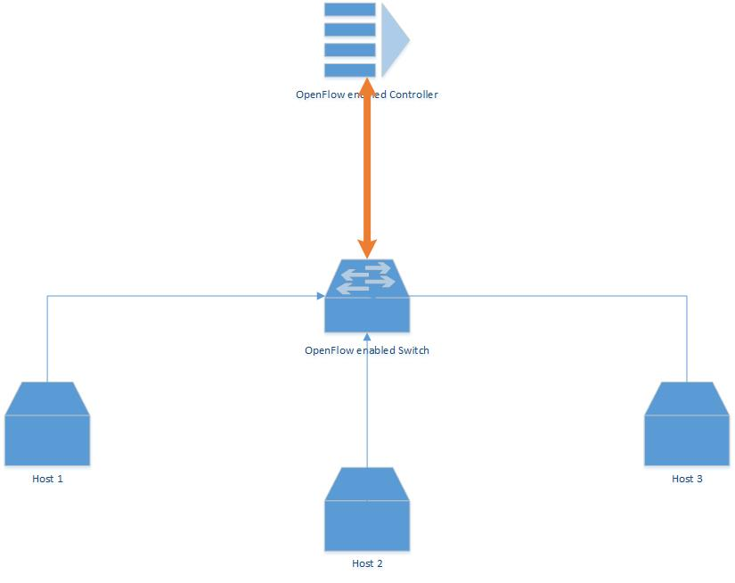
Demo
POX- Python Controller example code

Slide 6
Industry Trends
November 2007
OpenFlow Standard v0.2 whitepaper
March 2008
OpenFlow: Enabling Innovation in Campus Networks
September 2009:
OpenvSwitch
Toroki LightSwitch 4810
December 2009
OpenFlow 1.0 released: First version suitable for building an OpenFlow Switch
November 2011
OpenFlow enabled switch from IBM- G8264

Slide 7

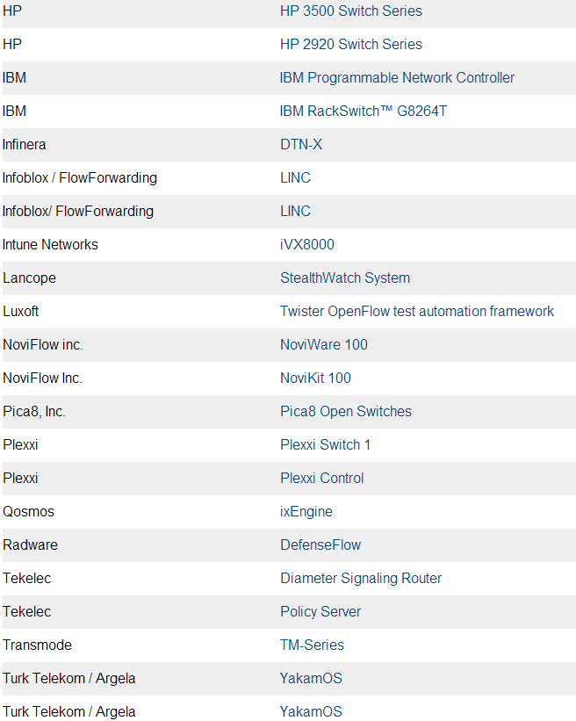
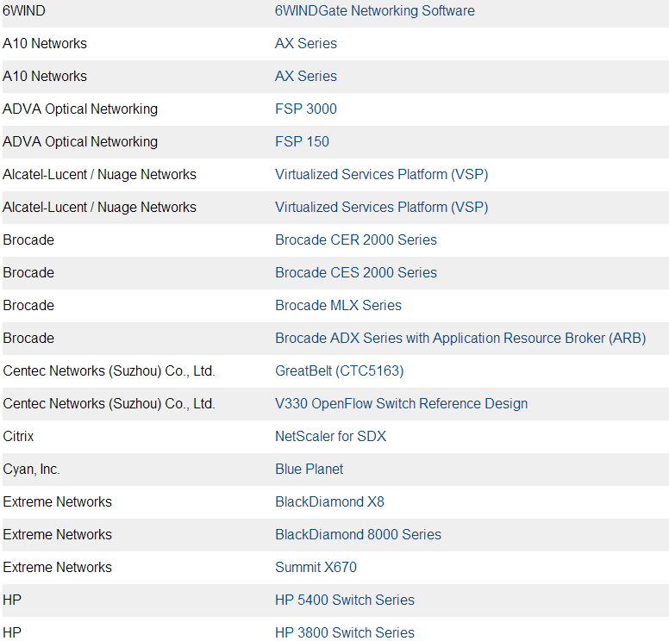
Product Availability

Slide 8
Cisco’s onePK
“onePK is an easy-to-use toolkit for development, automation, rapid service creation and more. It enables you to access the valuable data inside your network via easy-to-use APIs.”
Over 700 APIs for OpenFlow

Slide 9
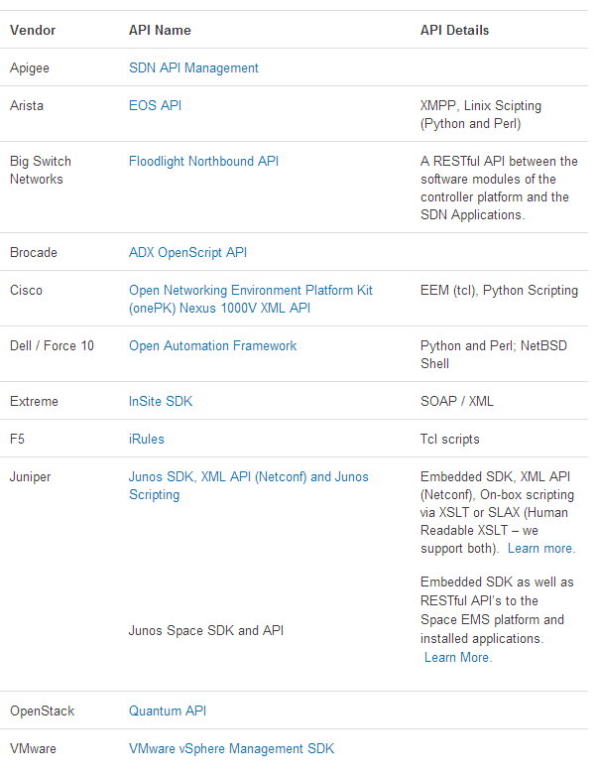
SDN API
http://www.sdncentral.com/comprehensive-list-of-sdn-apis/

Slide 10
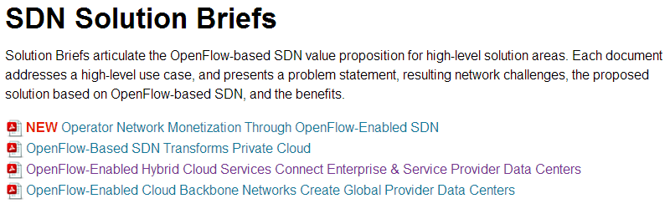
Use Cases
Generic
HyperScale and Enterprise Clouds
Enterprise Security
Enterprise Access Layer
Enterprise WAN
SP Mobile Access Layer
SP Wired WAN
Production
Google attains close to 100% utilization of networks by managing traffic with OpenFlow
Many others

Slide 11
Relevant Work
Not much published on SDN Engineering in conjunction with Software Engineering
Research work separated into four categories
OpenFlow Protocol
SDN Use Cases
SDN Engineering
Software Engineering

Slide 12
OpenFlow Protocol
OpenFlow: Enabling Innovation in Campus Networks
Fabric: A retrospective on Evolving SDN
DevoFlow: Scaling Flow Management for High-Performance Networks
Towards SmartFlow: Case Studies on Enhanced Programmable Forwarding in OpenFlow Switches

Slide 13
SDN Engineering
Controller Placement
Controller Scalability and Performance
Design and Implementation of Application Based Routing
Ethernet Scalability
Efficient/Scalable Control Applications
Performance Modeling of OpenFlow Architecture
New description language for SDN
Routing Controller Platform
Switch Interoperability Testing
Rapid Deployment of Network Protocols on Programmable Hardware
Generating Test Packets
Configuration Analysis and Verification of Federated OpenFlow Infrastructures

Slide 14
SDN Use Cases
Accelerating OpenFlow Switching with Network Processors
Mobile Apps on Global Clouds using SDN
AutoSlice: Automated and Scalable Slicing for SDN
CloudNaas: A Cloud Networking Platform for Enterprise Applications
Elastic IP and Security Groups Implementation Using OpenFlow
Frenetic: A High-Level Language for OpenFlow Networks
Grouping Packet Scheduling for Virtual Networks by Genetic Algorithm
The Case for Software–Defined Networking in Heterogeneous Networked Environments
Improving PC-based OpenFlow Switching Performance
A Management Method of IP Multicast in Overlay Networks using OpenFlow
OpenFlow MPLS and the Open Source Label Switched Router
MPLS-TE and MPLS VPNs with OpenFlow
OFRewind: Enabling Record and Replay Troubleshooting for Networks
Implementing an OpenFlow Switch on the NetFPGA platform
Demo: Programming Enterprise WLANs with Odin
Outsourcing the Routing Control Logic: Better Internet Routing Based on SDN Principles
A Security Enforcement Kernel for OpenFlow Networks
VeriFlow: Verifying Network-Wide Invariants in Real Time
ACM MobiCom 2012 Poster: CloudMAC – Towards Software Defined WLANs

Slide 15
CMMI Dev- Engineering
Requirements Development(RD)
Technical Solution(TS)
Product Integration(PI)
Validation(VAL)
Verification(VER)

Slide 16
Requirements Development
In use cases mentioned above:
Market/Customer is usually a Networking entity looking to make improvements with SDN
Network requirements
Topology, Hardware
Bandwidth, latency
Redundancy, Scalability
Security, QoS
Others…

Slide 17
Technical Solutions
Before selecting a Vendor
Product line, products, costs
Topology
Performance/functional requirements
Support for OpenFlow/SDN
SDN attributes:
API / SDK support from hardware vendor
Hardware performance capability and flexibility to developer
Controller functionality and support
Use cases/ Technical Requirements translate to behavior of network:
Flow table definitions (filter criteria, actions)
Engineer logic of SDN software

Slide 18
Product Integration and Verification
Depending on Scale, Network will have several components:
Firewalls, servers, switches, routers, IDS/IPS, WLAN APs, Controllers, SAN, multiple hosts, and various other networking equipment
What networking protocols will be used in conjunction with the SDN Software?
Verify network as POC before deploying to production
Requirements
Technical Requirements

Slide 19
Validation
Production network satisfy the customer’s Requirements?
Is the Network function the intended Use Case?

Slide 20
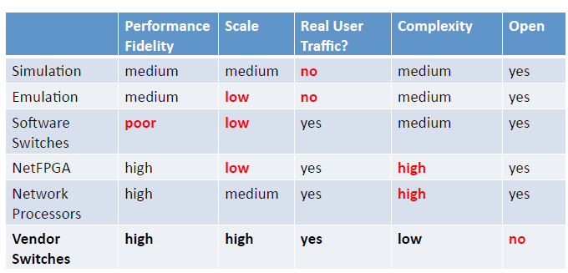
Future Research Work
Nascent SDN Market is slowly determining
Legitimacy of Use Cases
Costs/ overheads
Efficiency
New SDN applications will drive future research
Will SDN fill the gaps and where?
http://stanford.edu/~brandonh/downloads/OpenFlowTutorial_ONS.pdf

Slide 21
Conclusions
Growing market but yet to determine where it will saturate
Service Providers, Big Data, Enterprise, Federal customers, etc. have final say
However efficiency in Software Engineering/Development of SDN applications lead to less overheads

